Slide 1

ML4CV Group
Group Discussion
November 30, 2020

Slide 2
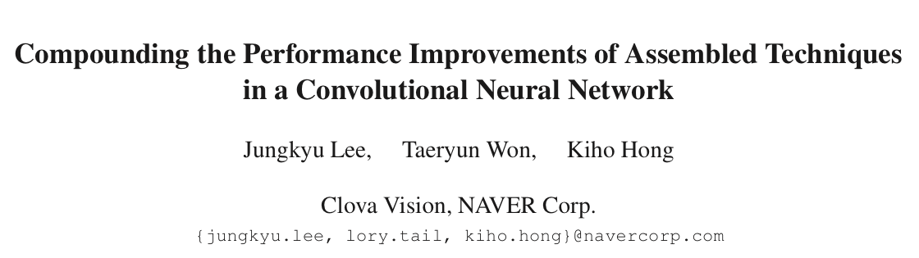

Slide 3
1. Introduction
Lu Dong

Slide 4

Introduction: background
Target: improve the performance of CNNs in image classification
One approach: design new network architectures
Another approach: “Tricks”
AlexNet
ResNet
NASNet/MNASNet
Inception
DenseNet
EfficientNet

Slide 5
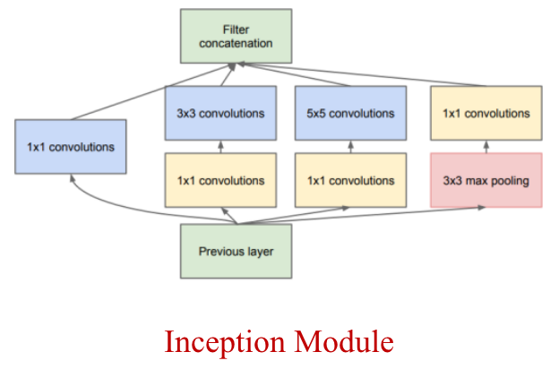
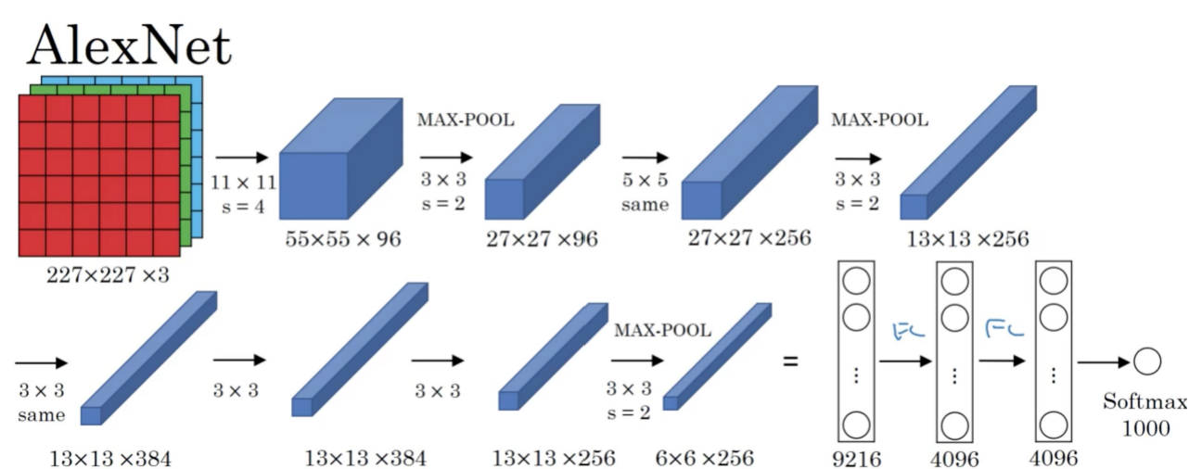
Introduction: AlexNet Inception
First deep CNN architecture
Convolution layers of different kernel sizes

Slide 6
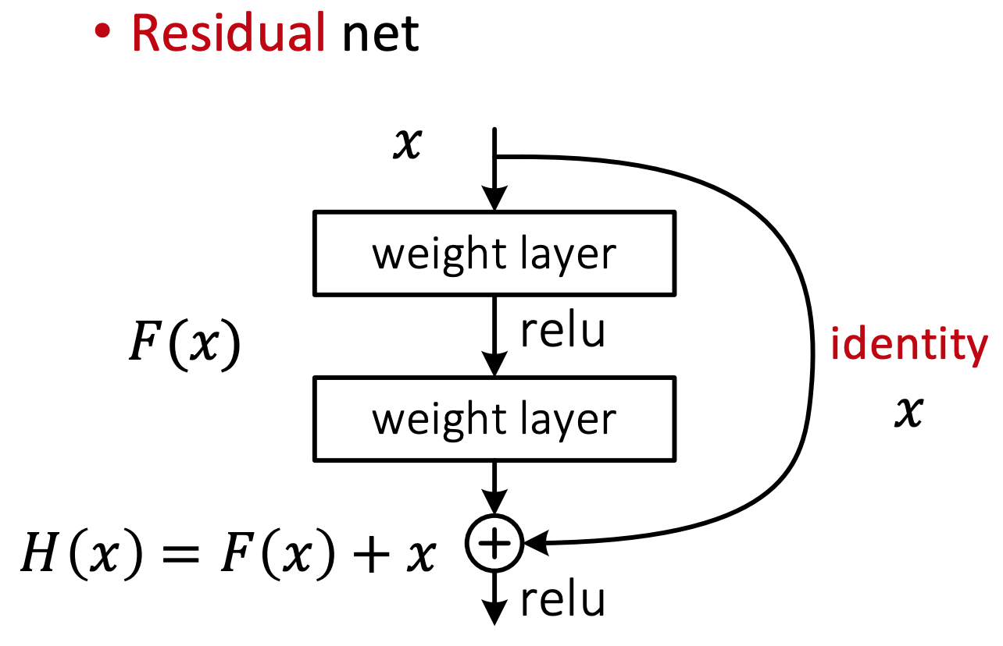
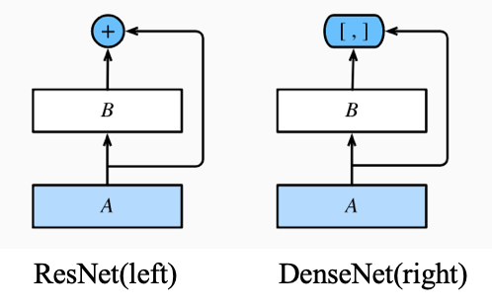
Introduction: ResNet DenseNet
skip connection
dense feature connections

Slide 7
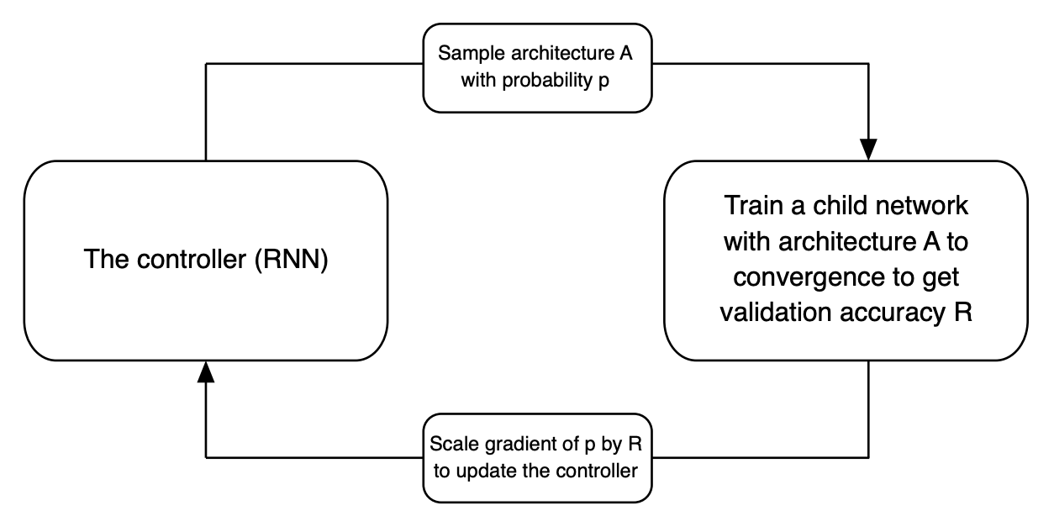
Introduction: NASNet/MNASNet
NASNet search space
Network design was automatically decided to create models

Slide 8
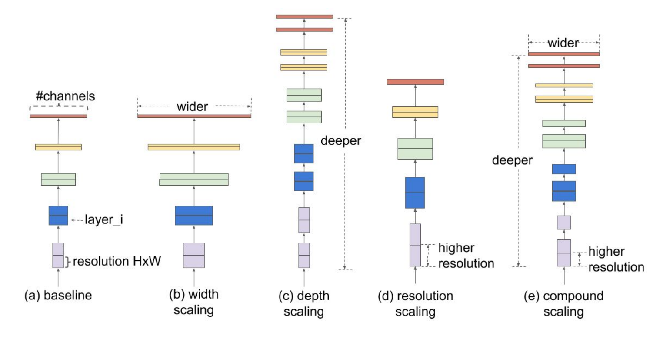
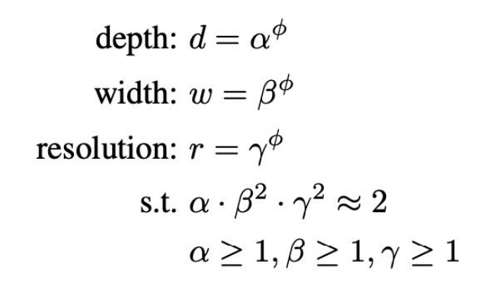
Introduction: EfficientNet
Compound Scaling
Depth: number of layers
Width: number of channels
Resolution: input size
An efficient network by balancing the resolution, height, and width of the network

Slide 9
Introduction: our approach
One approach: design new network architectures
Another approaches: “Tricks”
Data preprocessing
Learning rate decay
Parameter initialization
Our approach:
Assembling these techniques into a single network

Slide 10
Introduction: contribution summary
Organize the existing CNN-related techniques:
Network tweaks → SENet
Modify the CNN architectures to be more efficient
Regularization:
Use data augmentation to prevent overfitting
AutoAugment
Mixup
Dropout/DropBlock

Slide 11
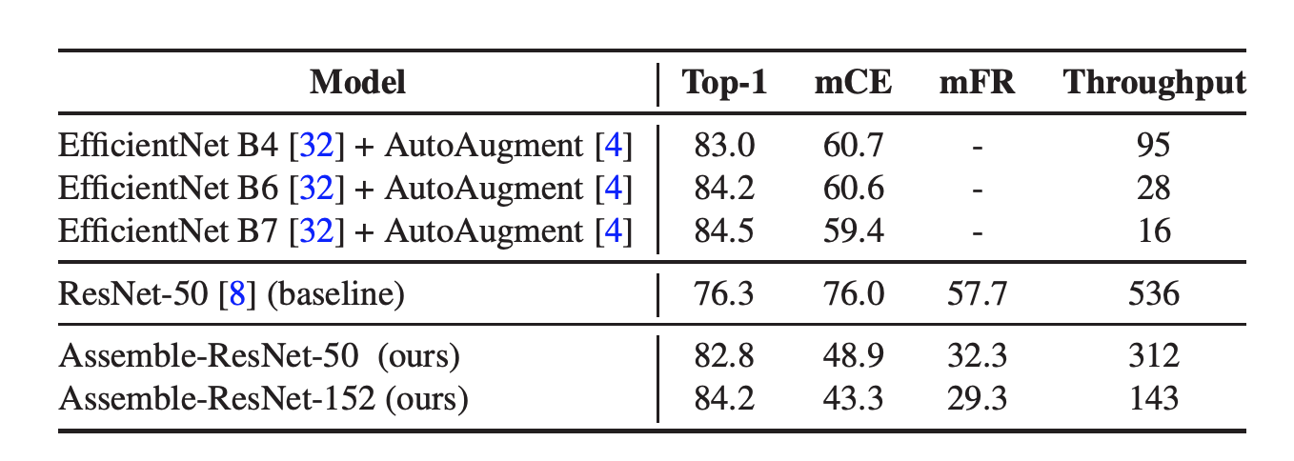
Introduction: contribution summary
Provide detailed experimental results:
Performance indicators:
Top-1 accuracy
mCE (mean corruption error)
mFR (mean flip rate)
Throughput

Slide 12
2. Preliminaries
Zhiqiang Wang

Slide 13
Preliminaries——Training Procedure
Model: ResNet
Dataset: ImageNet ILSVRC-2012 dataset (1.3M training images and 1,000 classes)
Machine: a single machine with 8 Nvidia Tesla P40 GPUs; CUDA 10 platform and cuDNN 7.6
• Preprocessing
Traininig: aspect ratio from 3/4 to 4/3
area size from 5% to 100%
resized as 224 * 224
flipped horizontally prob: 0.5
Validation: hold the aspect ratio
resize the shorter size to 256
center crop the image to 224*224
• Zero γ
Initialize γ = 0 for all batch-norm layers that sit at the
end of a residual block. It is easier to train by creating
an effect that shrinks the entire layer at initial the
stage.???
• Mixed-precision floating point
Only use mixed-precision floating point in the training
phase because mixed-precision accelerates the overall
training speed if the GPU supports it.
Only acceleration, no improvement in accuracy.
• Hyperparameter
Batch sizes: 1024 Initial learning rate: 0.4
Weight decay: 0.0001. Default epochs: 120
Optimizer: SGD with momentum 0.9
• Cosine learning rate decay
The cosine decay starts at a low rate from the begining
of training, and then drops to a large rate in the middle
and again at a small rate in the end.
• Learning rate warmup
Linearly increase the learning rate from 0 to the initial
learning rate at warm-up periods set to first 5 epochs.
Notes:
cosine learning rate decay.

Slide 14
Preliminaries——Evaluation Metrics
Three metrics used to measure the performance of the model
• Top-1 classification accuracy on ImageNet ILSVRC-2012 validation dataset.
• Throughput defined as how many images are processed per second on the
GPU device. We measured inference throughput for an Nvidia P40 1 GPU.
• Mean Corruption Error (mCE) measure the performance of classification
model on corrupted images proposed by Hendrycks et al^{. [1]}
[1] Dan Hendrycks and Thomas Dietterich. Benchmarking neural network robustness to common corruptions and perturbations. arXiv preprint arXiv:1903.12261, 2019.

Slide 15
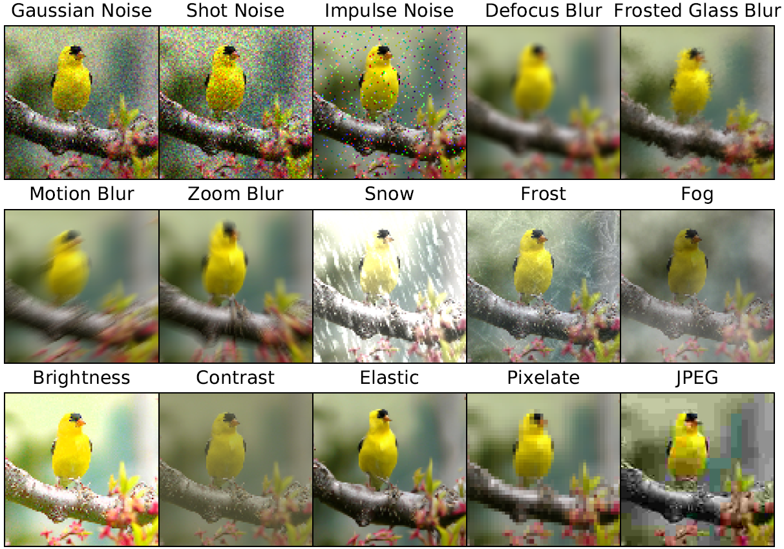
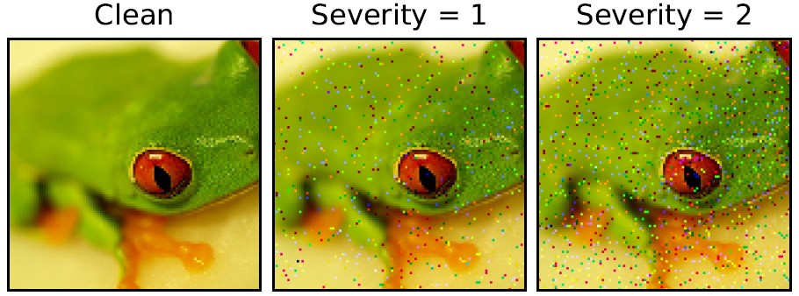
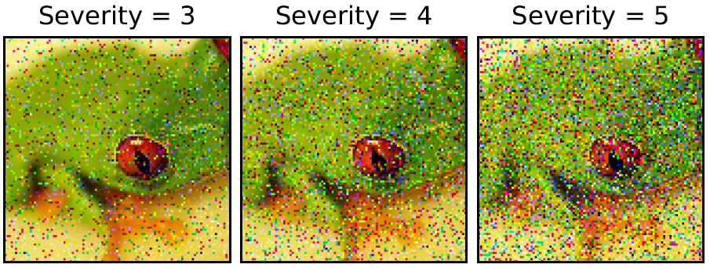
ImageNet-C Benchmark
ImageNet-C
generated by applying a set of 75 common visual corruptions to validation images of ImageNet.
15 diverse corruotion types
5 different severity levels

Slide 16
3.1 Network Tweaks
Speaker: Zhu Liu
Notes:
Compounding the Performance Improvements of Assembled Techniques in a Convolutional Neural Network.

Slide 17
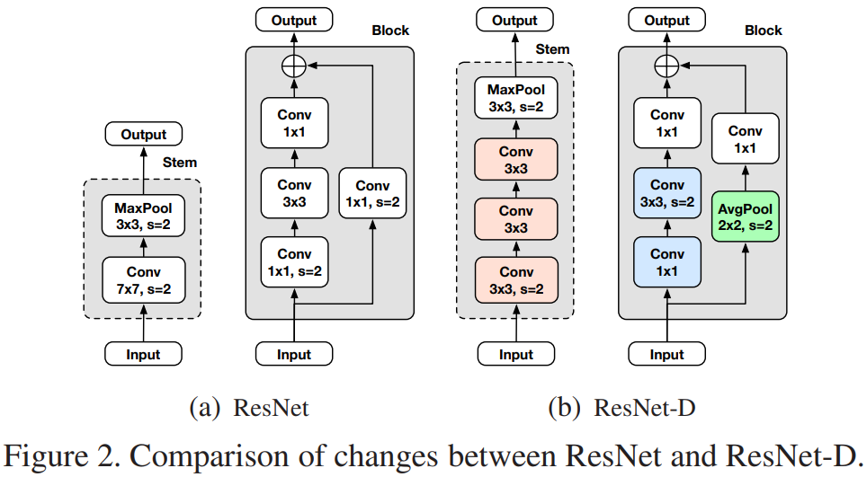
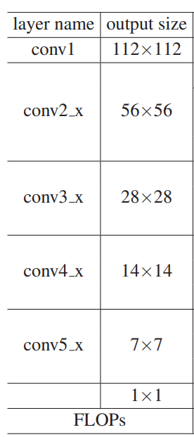
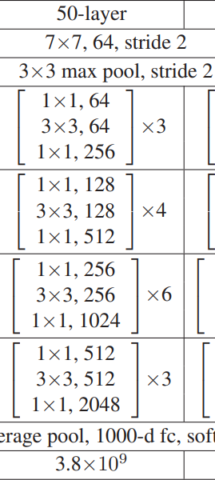
ResNet-D
Blue: The stride sizes of the first two convolutions have been switched.
Green: A 2*2 average pooling layer has been added with a stride of 2 before the convolution.
Red: A large 7*7 convolution has been replaced with three smaller 3*3 convolutions in Stem layer.

Slide 18
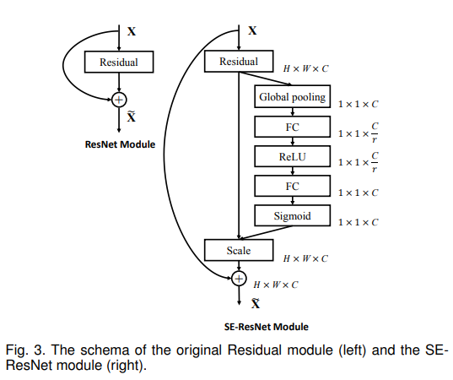
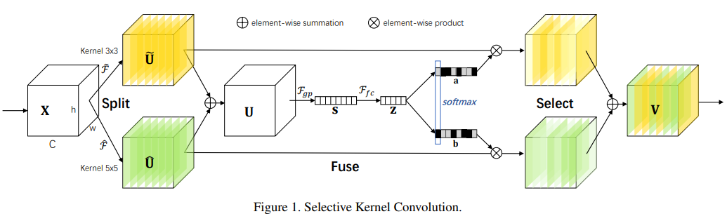
Channel Attention (SE, SK)
“SK is used inspired by the fact that the receptive sizes of neurons in the human visual cortex are different from each other.”

Slide 19
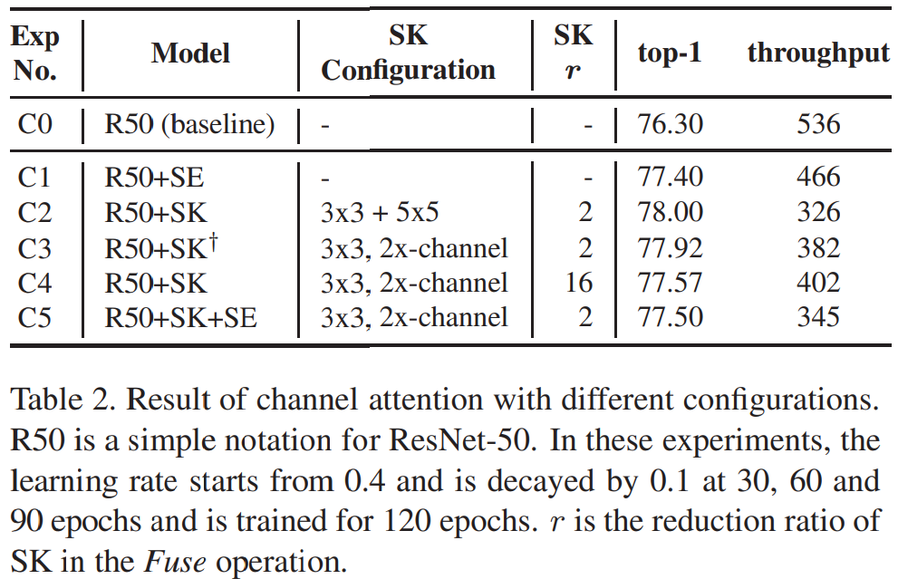
Channel Attention (SE, SK)

Slide 20
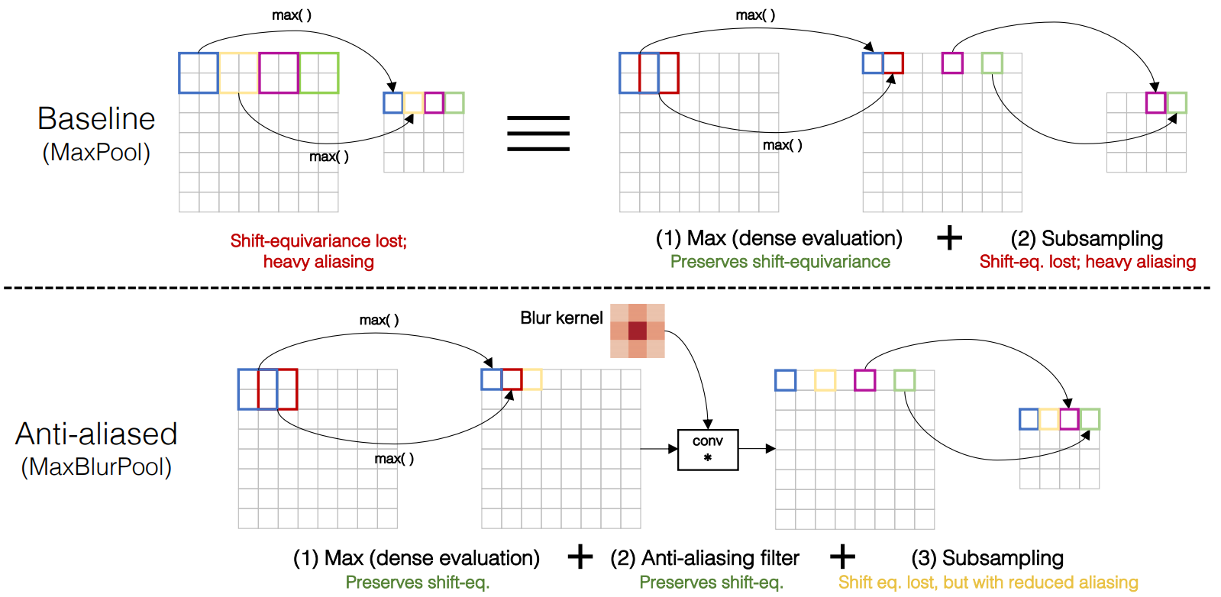
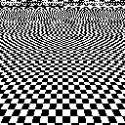
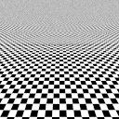
Anti-Alias Downsampling (AA)
Anti-Alias
To improve the shift-equivariance of deep networks.
AA can be applied to max-pooling, projection-conv, and strided-conv of ResNet.

Slide 21
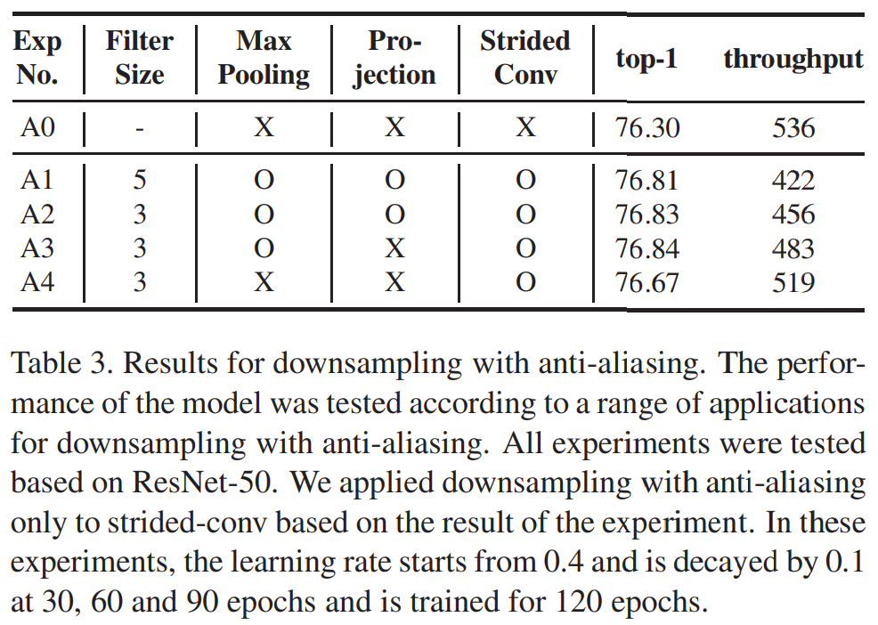
Anti-Alias Downsampling (AA)

Slide 22
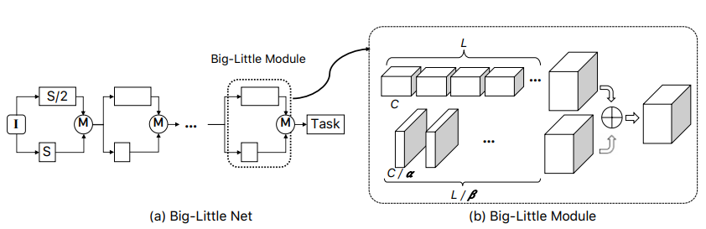
Big Little Network (BL)
Different resolutions while aiming at reducing computational cost and increasing accuracy.
Notes:
SK Net: https://arxiv.org/pdf/1903.06586.pdf

Slide 23
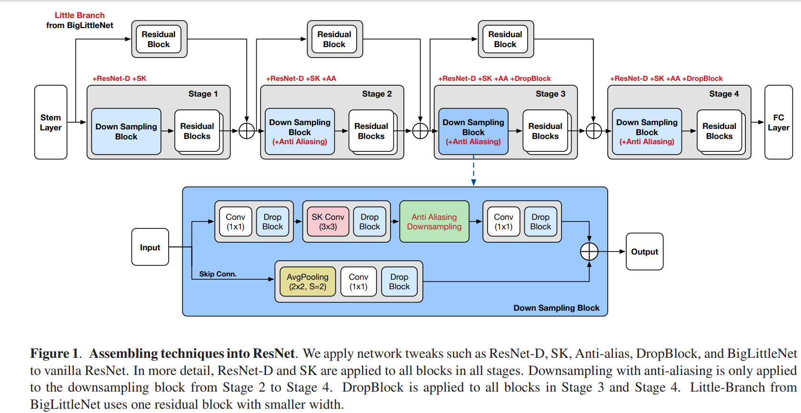
Overall
ResNet-D

Slide 24
Reference
Zhang, Richard. "Making convolutional networks shift-invariant again." (ICML 2019). Anti-Alias Downsampling
Chen, Chun-Fu, et al. "Big-little net: An efficient multi-scale feature representation for visual and speech recognition." arXiv preprint arXiv:1807.03848 (2018). Big-little net
He, Tong, et al. "Bag of tricks for image classification with convolutional neural networks." Proceedings of the IEEE Conference on Computer Vision and Pattern Recognition. 2019. ResNet-D
Hu, Jie, Li Shen, and Gang Sun. "Squeeze-and-excitation networks." Proceedings of the IEEE conference on computer vision and pattern recognition. 2018. SE
Li, Xiang, et al. "Selective kernel networks." Proceedings of the IEEE conference on computer vision and pattern recognition. 2019. SK

Slide 25
3.2 Regularization
by Qiushi Lin

Slide 26
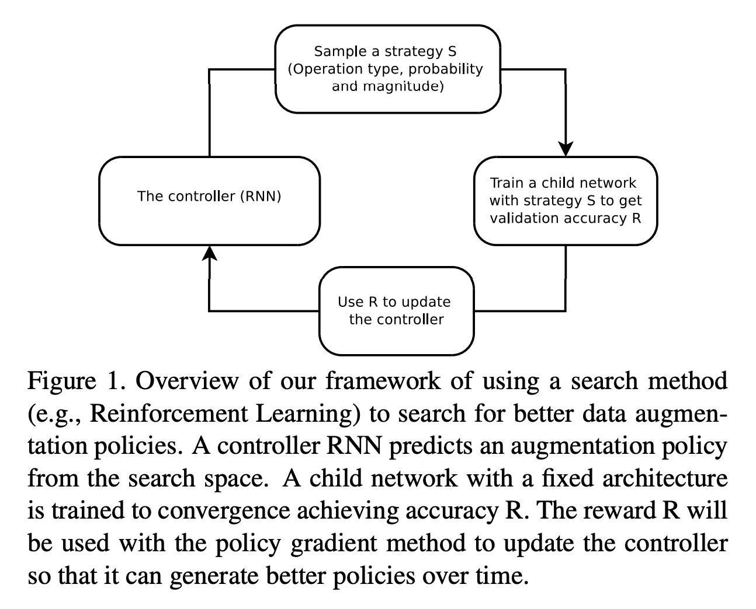
AutoAugument
Search Space
a policy consists of 5 sub-policies with each sub-policy consisting of two image operations to be applied in sequence
each operation is also associated with two hyperparameters
the probability of applying the operation
the magnitude of the operation
operations selected from a popular Python image library, PIL (https://pillow.readthedocs.io/en/5.1.x/)

Slide 27
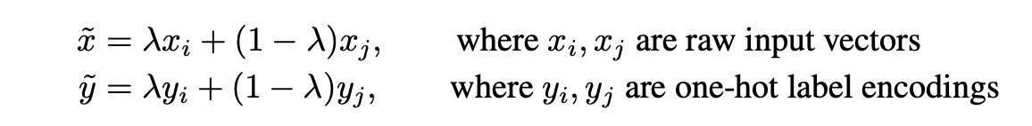
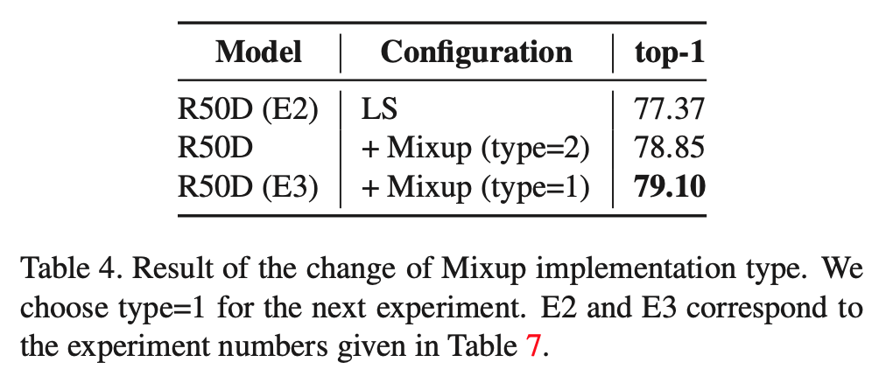
Mixup
Two types of implementation
use two mini batches to create a mixed mini batch, which is is suggested in the original paper
use a single mini batch to create the mixed mini batch by mixing the mini batch with a shuffled clone of itself

Slide 28
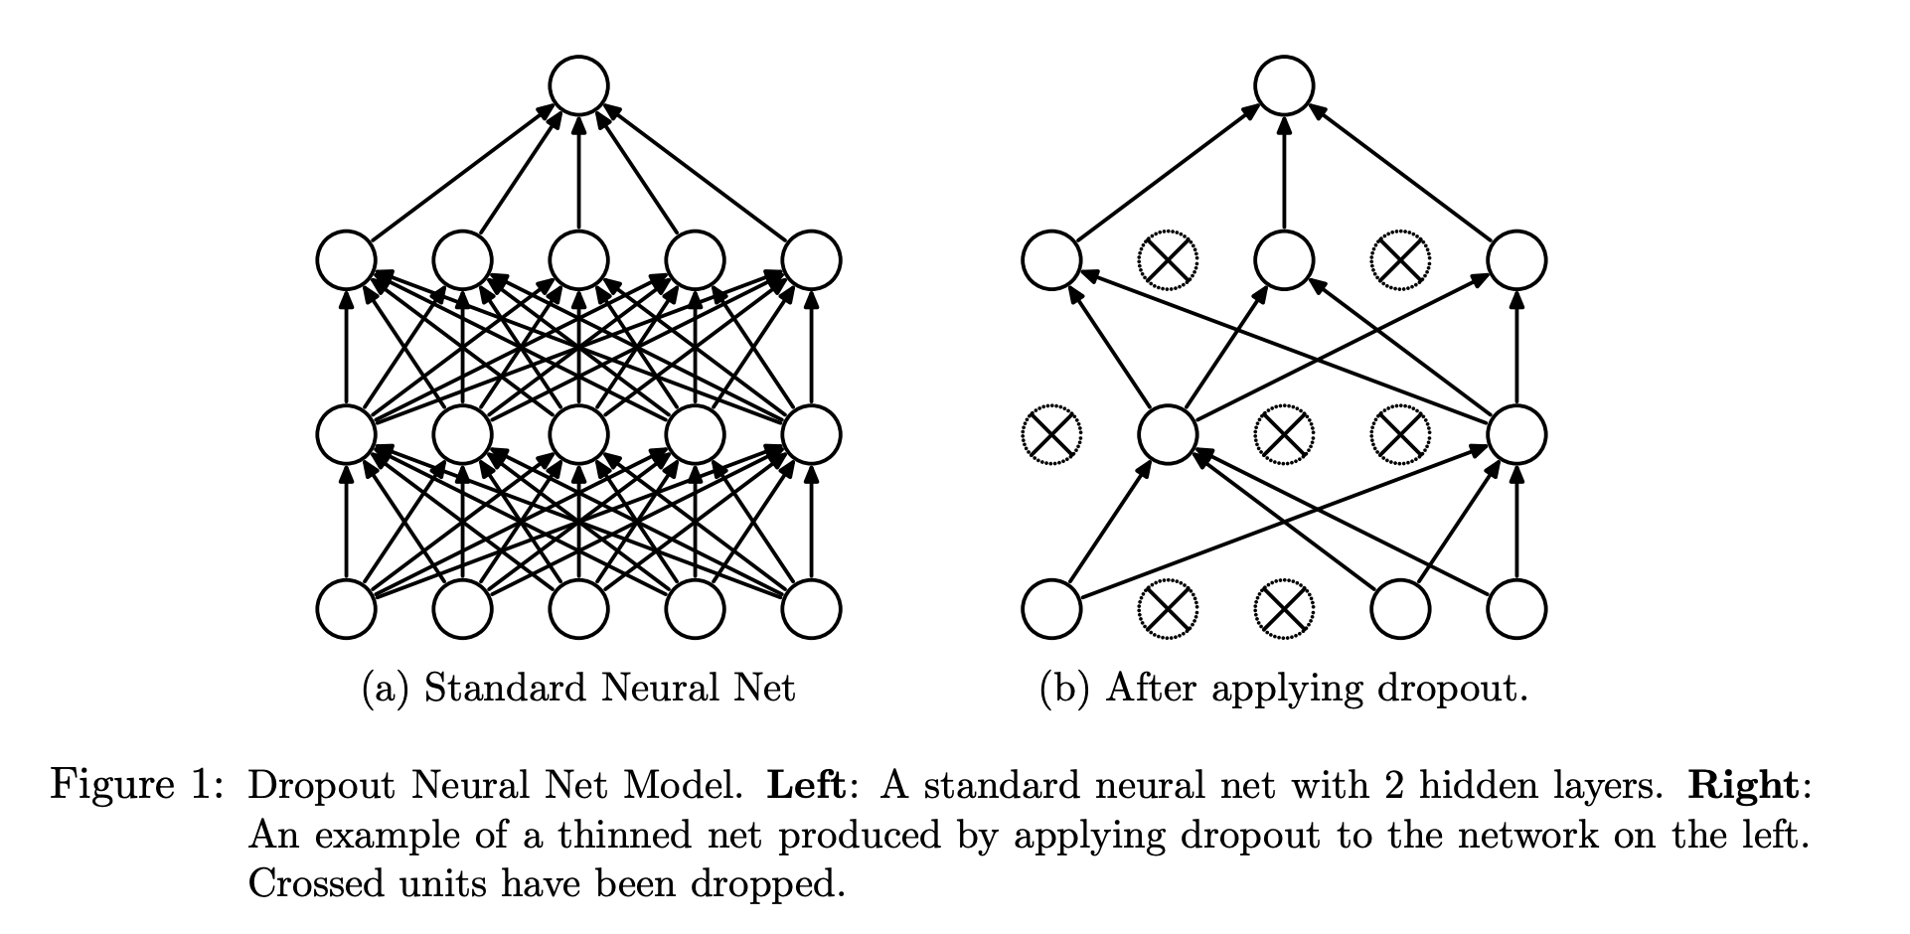
DropBlock

Slide 29
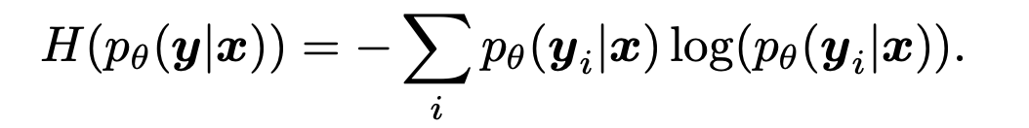
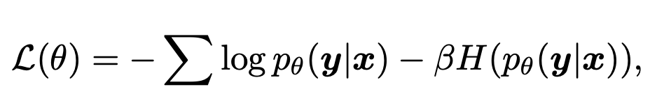
Label Smoothing
suppress infinite output and prevent over-fitting
The entropy of this conditional distribution
To penalize confident output distributions, we add the negative entropy to the negative log-likelihood during training

Slide 30
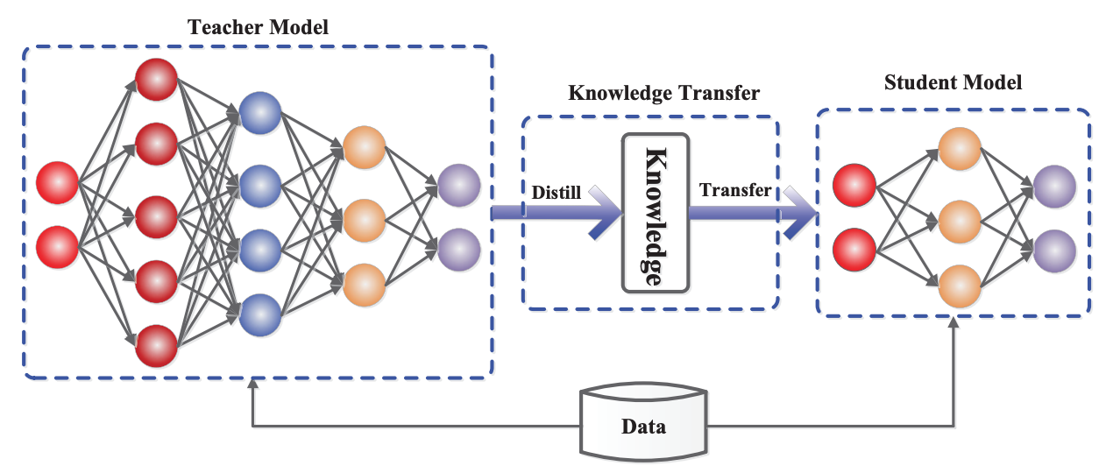
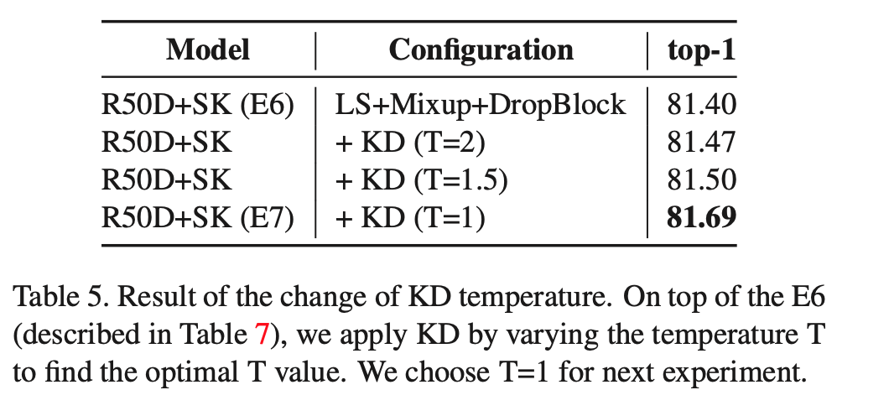
Knowledge Distillation
Speciality:
T = 1, as the Mixup technique has already smoothed the teacher’s signal
use AmoebaNet-A as a teacher with 83.9% of ImageNet validation top-1 accuracy

Slide 31
4.1 Experiment result Ablation study
Gengtiantian

Slide 32
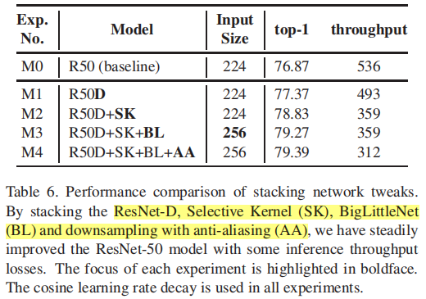
Ablation experiments for assembling the individual network tweaks covered in Section 3.1 to find better model.
The results show that:
1) ResNet-D and SK can improve performance independently with little effect on each other.
2) To achieve higher accuracy while maintaining throughput similar to that of the R50D+SK, we apply BL using a 256x256 image resolution for inference, whereas we use 224x224 image resolution for training.
3) Applying AA just improves top-1 accuracy by 0.12%, because AA is a network structure designed for robustness to image distortion, the top-1 accuracy does not reliably determine the AA effect.

Slide 33
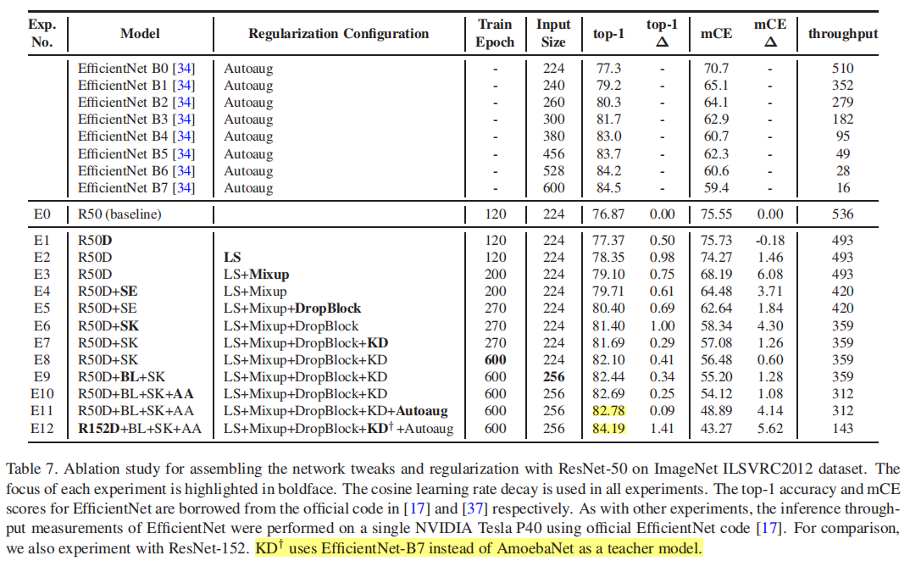
The impact of assembling the techniques described in Section 3.2. We stack the network tweaks and regularizations alternately to balance the performance effects.
1) The performance improvement effect of mCE is greater than the improvement of accuracy (E2,3,5,7,11).
2) SE is similar to the result of the regularization techniques confirming that channel attention is also helpful for robustness to image distortion.
3) BL and AA show a high performance improvement not only on top-1, but also on mCE. (E9.E10).

Slide 34
4.2 Transfer Learning: FGVC
Minghui Chen

Slide 35
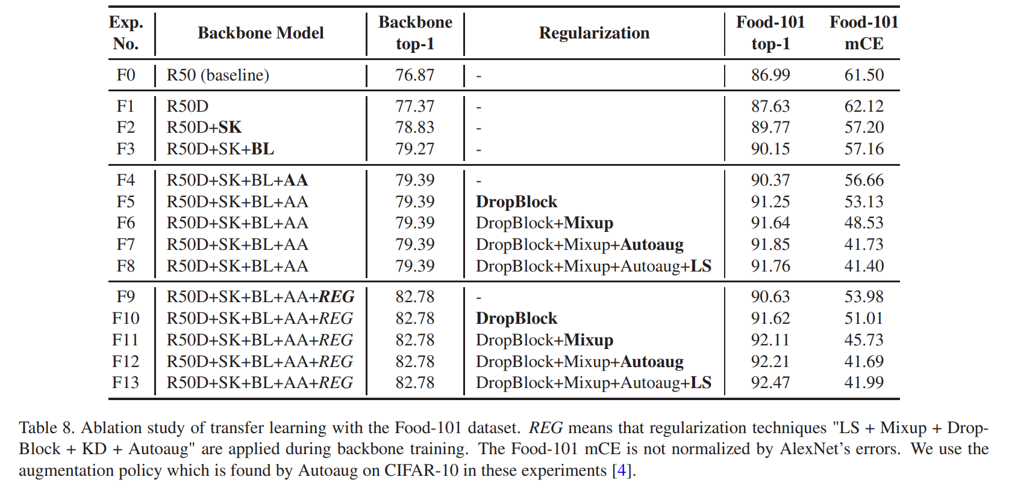
Stacking network tweaks and regularization
REG in fine-tuning narrows the mCE gap.
REG in backbone is effective

Slide 36
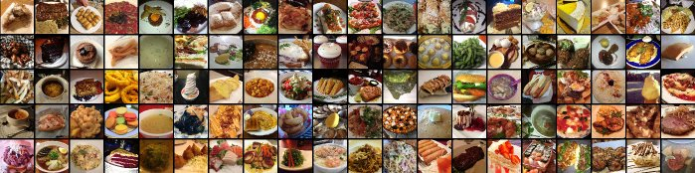
Dataset introduction
Food-101: They introduce a challenging data set of 101 food categories, with 101,000 images. For each class, 250 manually reviewed test images are provided as well as 750 training images. All images were rescaled to have a maximum side length of 512 pixels.
On purpose, the training images were not cleaned, and thus still contain some amount of noise. This comes mostly in the form of intense colors and sometimes wrong labels.

Slide 37
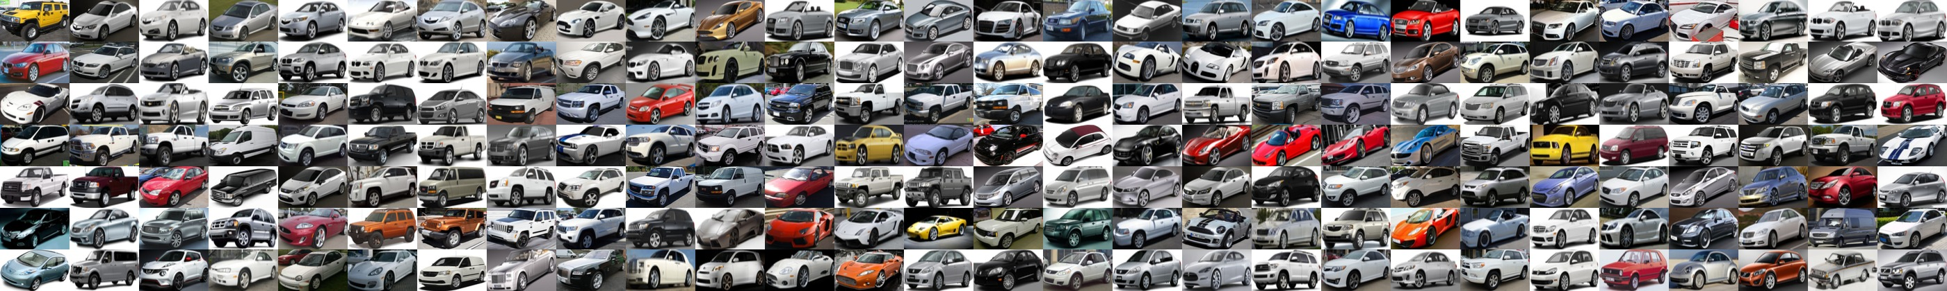
Dataset introduction
Stanford Cars: The Cars dataset contains 16,185 images of 196 classes of cars. The data is split into 8,144 training images and 8,041 testing images, where each class has been split roughly in a 50-50 split. Classes are typically at the level of Make, Model, Year, e.g. 2012 Tesla Model S or 2012 BMW M3 coupe.

Slide 38
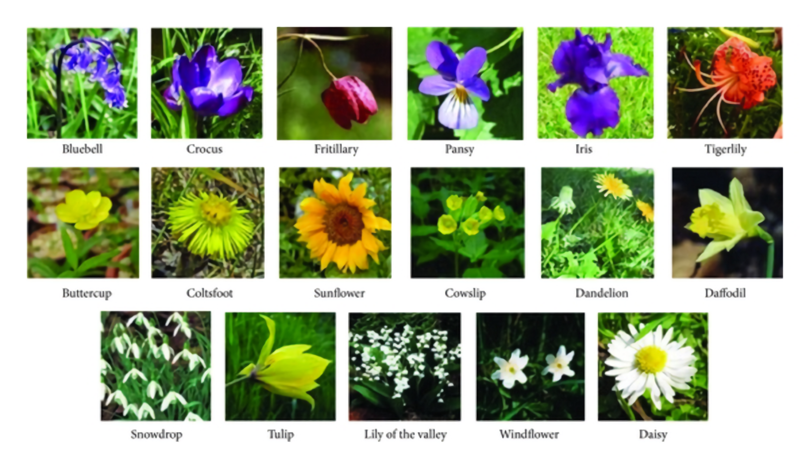
Dataset introduction
Oxford-Flowers: They have created two flower datasets by gathering images from various websites, with some supplementary images from our own photographs. The first dataset is a smaller one consisting of 17 different flower categories, and the second dataset is much larger, consisting of 102 different categories of flowers common to the UK.

Slide 39
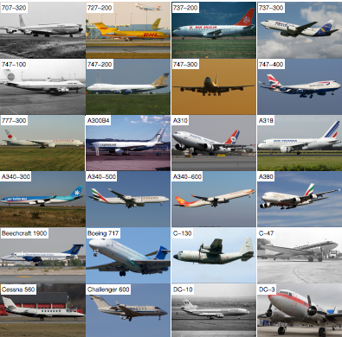
Dataset introduction
FGVC Aircraft: Fine-Grained Visual Classification of Aircraft (FGVC-Aircraft) is a benchmark dataset for the fine grained visual categorization of aircraft. The dataset contains 10,200 images of aircraft, with 100 images for each of 102 different aircraft model variants, most of which are airplanes. The (main) aircraft in each image is annotated with a tight bounding box and a hierarchical airplane model label.

Slide 40
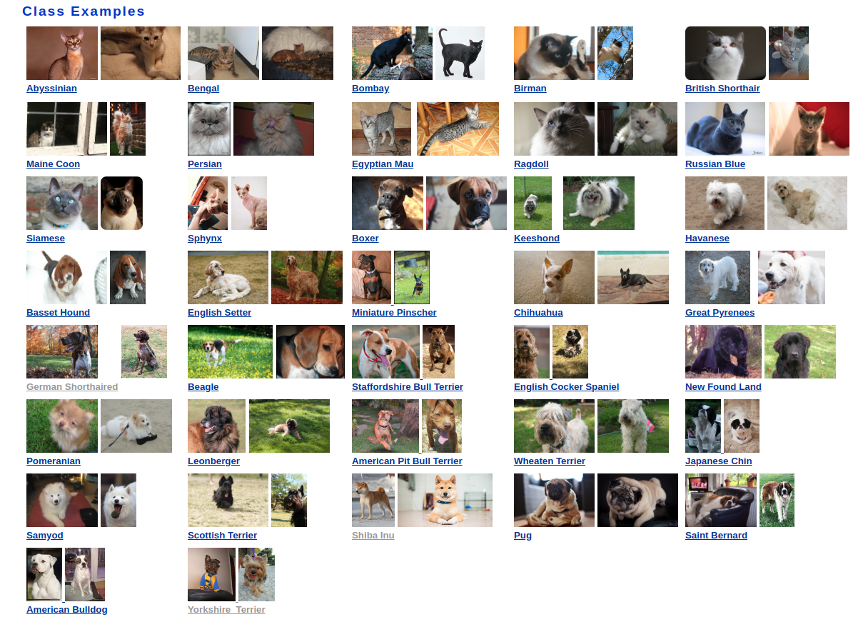
Dataset introduction
Oxford-IIIT Pets: They have created a 37 category pet dataset with roughly 200 images for each class. The images have a large variations in scale, pose and lighting. All images have an associated ground truth annotation of breed, head ROI, and pixel level trimap segmentation.

Slide 41
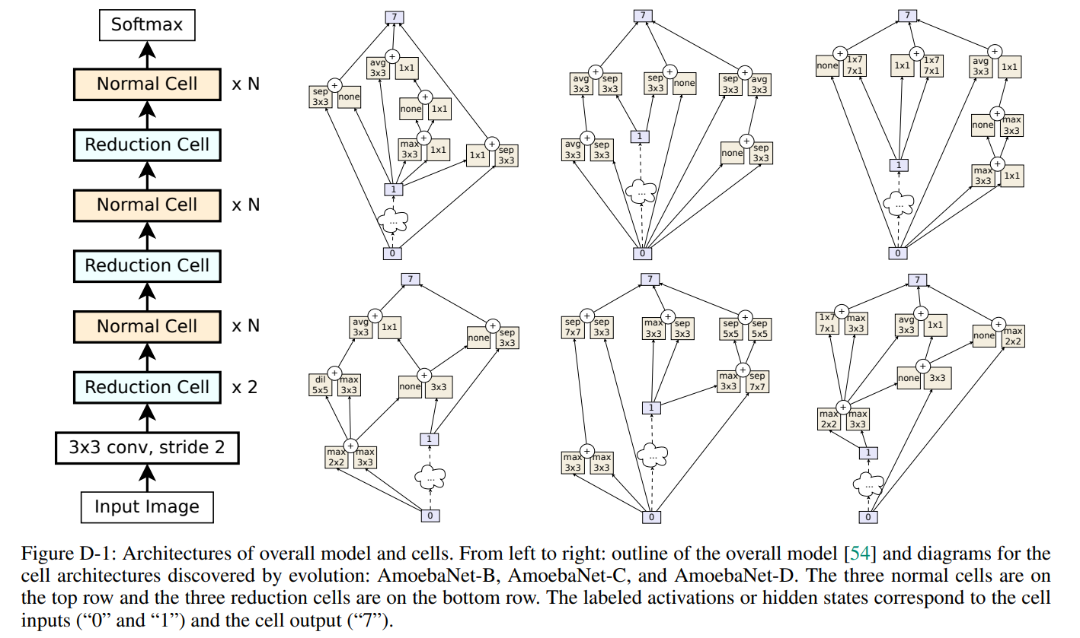
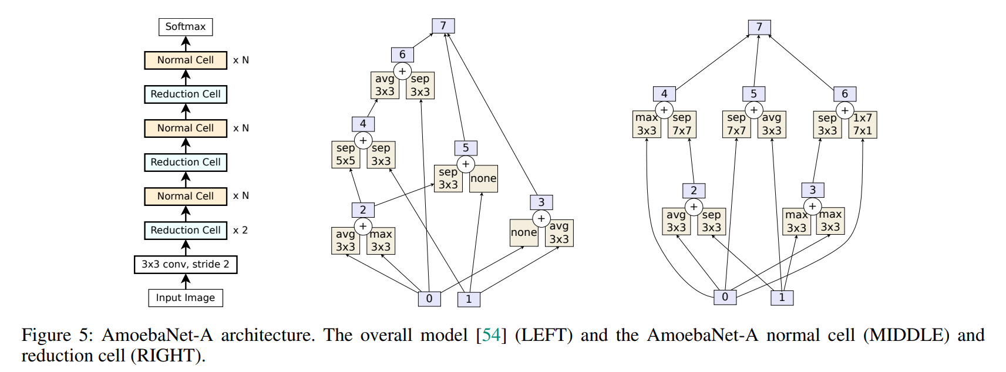
AmoebaNet
Regularized evolution for image classifier architecture search
AmoebaNet-B was obtained through platform-aware architecture search over a larger version of the NASNet space.

Slide 42
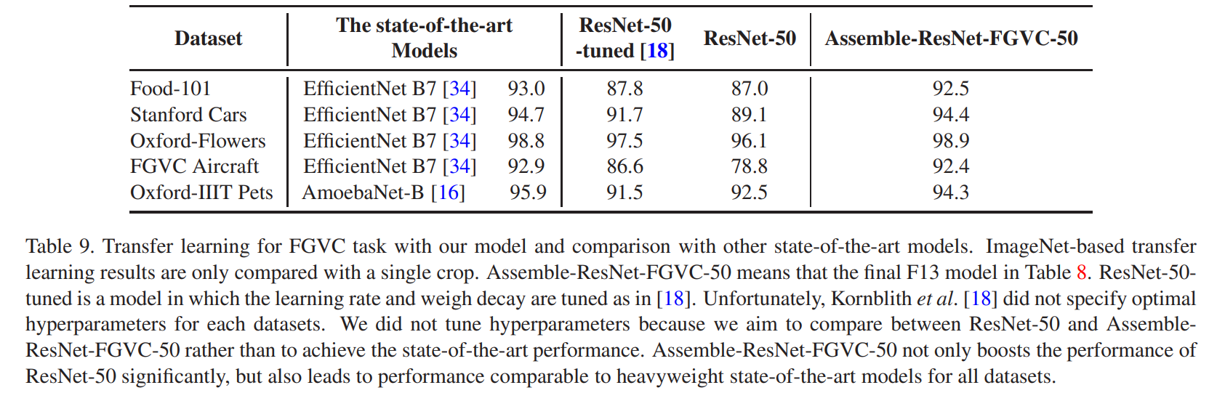
Transfer learning performance

Slide 43
4.3 Transfer Learning: Image Retrieval
Jiang Xi

Slide 44
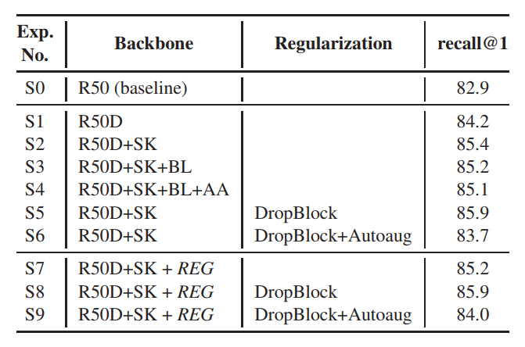
BL and AA did not work well on the SOP dataset.
DropBlock works well, but Autoaug do not improve the recall@1 performance

Slide 45
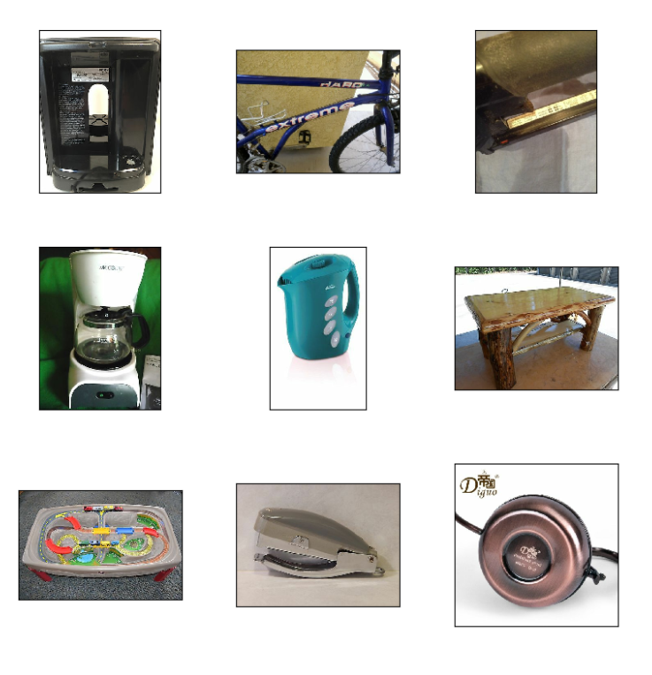
SOP collected Stanford Online Products dataset: 120k images of 23k classes of online products for metric learning.

Slide 46
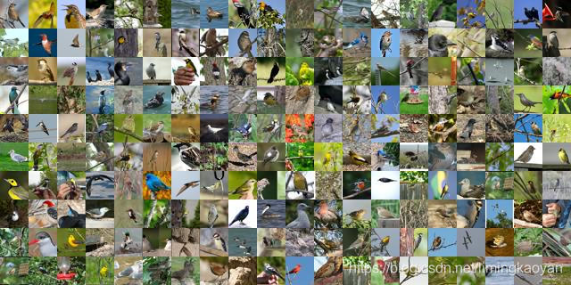
CUB200
Caltech-UCSD Birds 200 (CUB-200) is an image dataset with photos of 200 bird species (mostly North American).
Warning: Images in this dataset overlap with images in ImageNet.

Slide 47
